Slide 1
Low prevalence of calcified coronary plaque among Ugandans with and without HIV infection: comparison with a United States cohort and associations with biomarkers of inflammation
Chris T Longenecker^{1,2}, Ben Alencherry², Geoffrey Erem^{3,4}, Grace Mirembe⁵, Joselyne Nansimbe⁵, Isaac Ssinabulya^{4,6}, Chun-Ho Yun⁷, Chung-Lieh Hung⁷, Mark J. Siedner^{8,9}, Cissy Kityo⁵, Grace A. McComsey^{1,2}
¹ Case Western Reserve University School of Medicine; Cleveland, OH, USA ² University Hospitals Cleveland Medical Center; Cleveland, OH, USA ³ Nsambya St. Francis Hospital; Kampala, Uganda ⁴ Makerere University School of Medicine; Kampala, Uganda ⁵ Joint Clinical Research Centre; Kampala, Uganda ⁶ Uganda Heart Institute; Kampala, Uganda ⁷ Mackay Memorial Hospital; Taipei, Taiwan ⁸ Massachusetts General Hospital; Boston, MA, USA ⁹ Harvard Medical School; Boston, MA, USA
Notes:
Good morning and thank you to the conference organizers for the opportunity to present this work on behalf of our team. A special thank you to the people living with HIV in the US and in Uganda who participated in this research.

Slide 2
HIV is associated with higher risk of coronary disease
USA
Denmark
Sub-Saharan Africa ???
Canada
USA
USA
France
USA
Adapted from S. Grinspoon
Notes:
Over the past 2 decades a large number of epidemiologic studies have shown an association between HIV and risk of atherosclerotic cardiovascular events such as myocardial infarction. The magnitude of that risk appears to be about 1.5-2 fold higher risk in HIV vs. uninfected persons. However, as most in this room know, these studies have almost exclusively been performed in the USA, Europe, or Canada. Whether the magnitude of this increased risk in HIV is the same in sub-Saharan Africa– where HIV prevalence rates are highest– is unclear.

Slide 3
The global burden of HIV related CVD is estimated to be greatest in sub-Saharan Africa
Legend
<1.53
1.53 to 3.00
3.01 to 6.42
6.43 to 13.56
13.57 to 31.37
31.38 to 81.35
81.36 to 1000.49
Age-standardized DALYs per 100,000 persons by country
Shah et al, Circulation 2018
Notes:
Attempts have been made to estimate the global burden of CVD related to HIV. In this study led by Anoop Shah from the University of Edinburgh, we used UNAIDS data on HIV prevalence and Global burden of Disease Study data on CVD DALYs to show that the age-standardized DALYs lost due to HIV related CVD are estimated to be highest in sub-Saharan Africa.

Slide 4
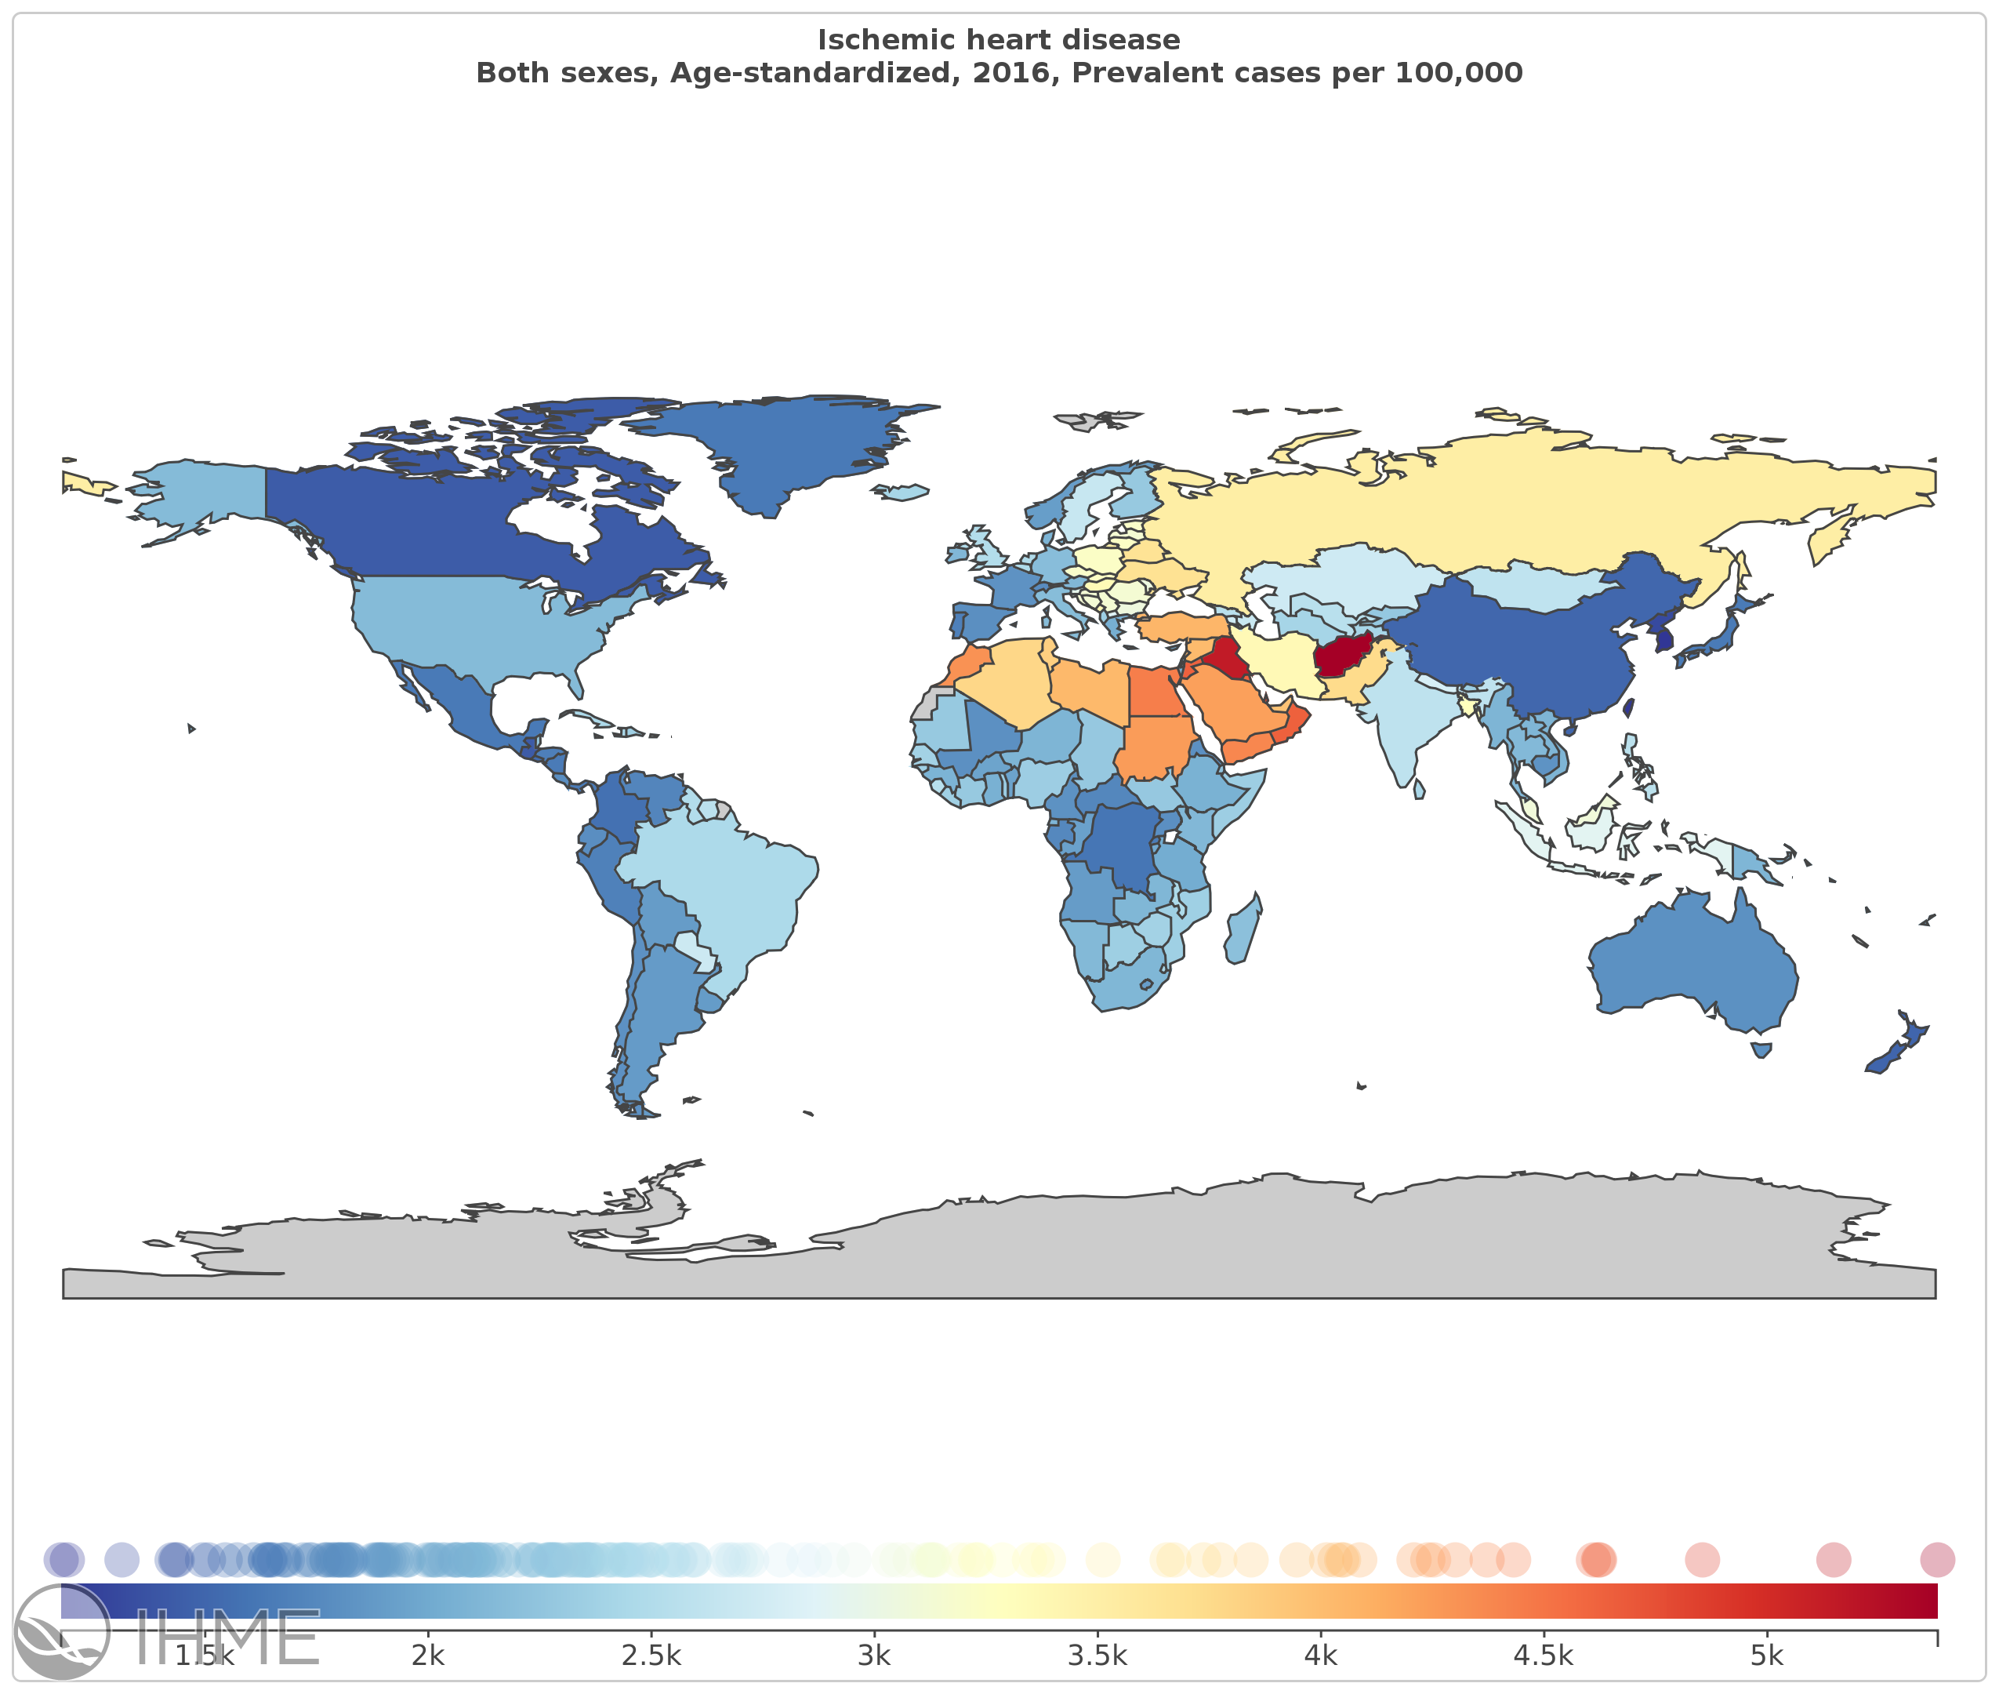
Global Burden of Disease Study estimates of age-standardized prevalence of ischemic heart disease
USA 2.1%
Uganda 1.8%
https://vizhub.healthdata.org/gbd-compare/
Notes:
Although these are the most sophisticated estimates that we have, they are, in the end, just estimates and could be substantially improved with better data from sub-Saharan Africa. The GBD’s current models of ischemic heart disease, for example, would suggest that the prevalence of age-standardized ischemic heart disease are similar in the USA and Uganda. Our group and others are increasingly interested in gathering data from sub-Saharan Africa to probe whether this is indeed true.

Slide 5
Hyle et al, BMC Public Health, 2017
Notes:
As illustrated by this systematic review published last year, there is a growing literature on CVD risk among people living with HIV in sub-Saharan Africa. However, the vast majority of these studies have only evaluated CVD risk factors (shown in black). Few have looked at surrogate measures of CVD risk using carotid ultrasound, measures of vascular stiffness and endothelial function. Even fewer have evaluated clinical outcomes such as acute coronary syndrome or stroke, and most of these clinical studies come from South Africa. To our knowledge, no prior studies have used cardiac CT to evaluate subclinical coronary atherosclerosis.

Slide 6
Aims
To compare prevalence of calcified coronary plaque between people with and without HIV in Uganda and the United States
To explore associations of calcified plaque with HIV-specific factors and biomarkers of inflammation and immune activation
Notes:
In this study, we therefore sought:
To compare prevalence of calcified coronary plaque between people with and without HIV in Uganda and the United States
To explore associations of calcified plaque with HIV-specific factors and biomarkers of inflammation and immune activation

Slide 7
Methods– Study Population
Uganda
100 HIV+ on ART and 100 age- and sex-matched uninfected controls
All >45 years of age with at least 1 risk factor for CVD (hypertension, diabetes, high cholesterol, smoking, or family history of CVD)
Cleveland
167 HIV+ on ART and 63 uninfected controls from a research database (PI McComsey)
All >40 years
Additional Inclusion/Exclusion varied by parent study
Notes:
Our Ugandan population consisted of 100 HIV+ and 100 age- and sex-matched uninfected control participants from in and around the capital city of Kampala. This was a study of higher risk individuals who were older than 45 years of age with at least 1 risk factor for CVD.
We compared the Ugandan cohort to individuals who have participated in prior studies of ours in Cleveland, Ohio USA. This included 167 HIV+ and 63 uninfected controls over 40 years of age. Additional inclusion/exclusion criteria varied by the parent study.

Slide 8
Methods– Cardiac CT
Uganda
  128 slice Siemens multi-detector CT scanner
  2.5mm slices
Cleveland
  64 slice Siemens multi-detector CT scanner
  3mm slices
Coronary Calcium (CAC) Scoring
  Agatston method
  Measured locally by radiologists in Cleveland and Uganda on Siemens Workstations
Notes:
All participants underwent non-contrast ECG-gated cardiac CT scans for coronary artery calcium scoring. The protocols in Uganda and Cleveland were performed on Siemens Somotom scanners and were quite similar except that in Uganda, the scanner was a newer 128-slice scanner compared to 64-slice scanner in Cleveland. The axial imaging slices were 2.5mm thick in Uganda compared to 3mm in Cleveland. Coronary artery calcium scoring was measured locally on Siemens workstations using the Agatston method.

Slide 9
Methods– Biomarkers
For all Ugandan participants, biomarkers of inflammation and immune activation were measured from frozen plasma stored at -80° C.
Analyses were performed at University Hospitals of Cleveland and the University of Vermont.
  Interleukin-6
  Soluble vascular cell adhesion molecule-1
  Soluble intercellular adhesion molecule-1
  Soluble tumor necrosis factor α receptor-2
  High sensitivity C-reactive protein
  Fibrinogen
  Soluble CD14 and CD163
  Oxidized LDL cholesterol
Notes:
For all Ugandan participants…
Samples were shipped to the US and analyses were performed at University Hospitals of Cleveland and the University of Vermont.
We measured the biomarkers shown here

Slide 10
Statistical analyses
Independent variables
  Country
  HIV status
  HIV-related variables (HIV only)
  Biomarkers of inflammation (Uganda only)
Outcome variable
  CAC > 0
Univariable and multivariable-adjusted logistic regression
  Unadjusted
  Minimally adjusted: age, sex
  Fully adjusted: age, sex, DM, HTN, current smoking, total cholesterol
Notes:
We performed 4 sets of analyses looking at the association of country, HIV status, HIV-related variables, and biomarkers of inflammation with the binary outcome measure of CAC score >0 using univariable and multivariable-adjusted logistic regression models. We built unadjusted models, minimally adjusted models which included age and sex, and fully adjusted models that adjusted for additional atherosclerotic CVD risk factors.

Slide 11
Characteristics of Study Participants
 | Uganda |  |  | Cleveland |  |  | UG vs. CLE
 | HIV-neg N=100 | HIV+ N=100 | p-value | HIV-neg N=63 | HIV+ N=167 | p-value | p-value
Age | 55 (51-60) | 55 (51-60) | 0.474 | 53 (49-57) | 50 (46-55) | 0.003 | <0.001
Male | 38% | 38% | 0.999 | 62% | 78% | 0.011 | <0.001
Diabetes | 45% | 26% | 0.005 | 7.9% | 1.2% | 0.018 | <0.001
Hypertension | 80% | 89% | 0.079 | 25% | 40% | 0.038 | <0.001
Current Smoker | 4% | 4% | 0.999 | 47% | 60% | 0.082 | <0.001
BMI | 30 (26-34) | 27 (23-32) | 0.014 | 28 (25-31) | 26 (23-29) | 0.191 | 0.009
Systolic BP | 152 (135-175) | 152 (140-167) | 0.398 | 126 (118-138) | 124 (114-138) | 0.320 | <0.001
Total Cholesterol (mg/dl) | 213 (181-245) | 216 (175-250) | 0.423 | 187 (152-214) | 174 (155-189) | 0.048 | <0.001
On statin | 5% | 7% | 0.767 | 21% | 11% | 0.051 | <0.001
On BP med | 52% | 45% | 0.322 | 25% | 38% | 0.066 | 0.004
Notes:
There were significant between-country differences in ASCVD risk factors, with red highlight indicating factors which are typically associated with higher CAC score. Ugandans were older with higher rates of hypertension and diabetes. They also had slightly higher BMI, higher systolic blood pressure despite treatment, and higher total cholesterol. Cleveland participants were more likely to be male, current smokers, and on statins. Within each country, differences by HIV status were smaller than the between-country differences. Among Ugandans, HIV+ participants were less likely to have diabetes compared to controls.
Hypertension was defined as systolic blood pressure >140mmHg or on treatment. Diabetes was defined as a self-reported history on medication.

Slide 12
Characteristics of HIV+ Participants
 | Uganda | Cleveland
 | HIV+ N=100 | HIV+ N=167 | p-value
Time since HIV dx (years) | 12 (10-13) | 15 (9.3-20) | <0.001
Current CD4 | 531 (408-676) | 629 (442-860) | 0.0145
Nadir CD4 | 141 (68-215) | 152 (63-290) | 0.111
Viral Load <48 | n/a | 81% | n/a
Duration of ART (years) | 11 (8.8-12) | 8.8 (4.2-14) | 0.244
PI-based regimen | 20% | 47% | <0.001
Integrase Inhibitor | 0% | 33% | <0.001
Current Abacavir | 6% | 13% | 0.001
Notes:
The characteristics of HIV+ participants from Uganda and Cleveland are shown here. Ugandan participants had modestly lower CD4+ T-cell count but similar nadir CD4+. All were on ART, with more PI and integrase inhibitor use among Cleveland participants.

Slide 13
Coronary artery calcium scores are lower in Uganda
p<0.001, Cleveland vs. Uganda
p=0.027, HIV+ vs. HIV-negative
After adjusting for age, sex, DM, HTN, smoking, total cholesterol
Ugandans had
13x lower odds of CAC >0
In multivariable model of CAC >0 among Ugandans only
OR for HIV was
2.2 (95%CI 0.74-6.4), p=0.16
Notes:
This figure shows our primary finding, which is that calcium scores were significantly lower in Uganda compared to Cleveland subjects divided into categories of CAC as shown here– yellow is no CAC, blue is CAC score of 1-100, and red is a CAC score >100. For subsequent analyses, we dichotomized CAC as 0 or >0. In addition to the between country difference, HIV+ participants had higher prevalence of CAC >0 overall. After adjusting for age, sex, DM, HTN, smoking, and total cholesterol, Ugandans had 13x lower odds of CAC >0. In a multivariable logistic regression model of Uganda subjects only, HIV was associated with higher odds of CAC >0, but this was not statistically significant. Age, current smoking, and HTN were the strongest predictors of CAC >0 among Ugandans.

Slide 14
Associations of HIV Variables with CAC >0 among all HIV+ (n=267)
Model 1: Adjusted for country
Model 2: Adjusted for country, age, sex
Model 3: Adjusted for country, age, sex, DM, HTN, current smoking, total cholesterol
* = p >0.1
 | Unadjusted |  | Model 1 |  | Model 2 |  | Model 3
 | OR | p-value | OR | p-value | OR | p-value | OR | p-value
Current CD4+ | * | * | * | * | * | * | * | *
Ln Nadir CD4+ | 0.80 (0.64-1.01) | 0.057 | 0.74 (0.57-0.95) | 0.018 | 0.73 (0.56-0.94) | 0.017 | 0.72 (0.56-0.94) | 0.017
HIV duration (years) | 1.04 (0.99-1.08) | 0.095 | * | * | * | * | * | *
ART duration (years) | * | * | * | * | * | * | * | *
Current ABC use | * | * | * | * | * | * | * | *
Current PI use | 1.95 (1.16-3.29) | 0.012 | * | * | * | * | * | *
Notes:
Among all HIV+ subjects, nadir CD4+ count was the only HIV specific variable associated with CAC in fully adjusted models. PI use was associated with CAC in unadjusted analysis, but not in adjusted models.

Slide 15
Associations of Biomarkers of Inflammation with CAC>0 among Ugandan Participants (n=200)
 | Unadjusted |  | Fully Adjusted Model †
 | OR (95% CI) | p-value | OR | p-value
IL-6 * | 1.20 (0.67-2.16) | 0.545 | 1.15 (0.61-2.18) | 0.666
sVCAM * | 2.29 (0.65-8.10) | 0.199 | 2.21 (0.53-9.19) | 0.277
sTNF-RII * | 4.81 (0.95-24.3) | 0.057 | 4.41 (0.71-27.3) | 0.110
hsCRP * | 0.94 (0.65-1.37) | 0.748 | 0.94 (0.63-1.41) | 0.780
sICAM * | 3.06 (0.97-9.69) | 0.057 | 4.11 (1.04-16.2) | 0.044
Fibrinogen * | 1.09 (0.28-4.34) | 0.899 | 1.13 (0.18-7.15) | 0.897
sCD14 * | 3.49 (0.56-21.8) | 0.182 | 1.94 (0.26-14.6) | 0.520
sCD163 * | 3.77 (1.27-11.2) | 0.017 | 6.40 (1.82-22.6) | 0.004
Oxidized LDL * | 1.33 (0.89-2.00) | 0.161 | 1.58 (1.01-2.46) | 0.043
* All biomarkers log-transformed for analyses. † Model adjusted for age, sex, DM, HTN, current smoking, total cholesterol
Notes:
The biomarker analyses are shown here. In fully adjusted models, associations with biomarkers tended to be positive with statistically significant associations seen with soluble ICAM (an endothelial activation marker), soluble CD163 (a marker of monocyte activation), and Oxidized LDL.

Slide 16
Limitations
Cross-sectional study
CAC is only an estimate of the underlying burden of subclinical coronary disease
Minor differences in scanners and CT protocol are unlikely to explain large differences between Uganda and Cleveland
Many underlying differences between groups increases the possibility of residual confounding
  On balance, however, Ugandans had higher prevalence of CVD risk factors
Notes:
Our study has several limitations. First, as with all cross-sectional studies, we cannot prove causal relationships. Secondly, although it is a better measure of ASCVD risk than other surrogate measures of vascular disease such as carotid ultrasound or endothelial function testing, CAC is only an estimate of the underlying burden of subclinical coronary disease. Third, although there were minor differences in scanners and CT protocol, we believe these are unlikely to explain large differences in CAC scores between Uganda and Cleveland. Finally, that fact that there were many underlying differences between groups increases the possibility of residual confounding. On balance, however, Ugandans had a higher prevalence of CVD risk factors and so this is also unlikely to explain our study findings.

Slide 17
In Conclusion
Despite a high burden of risk factors, this Ugandan cohort of PLWH and controls had substantially lower rates of calcified coronary plaque compared to a US cohort.
Lower nadir CD4+ count and higher systemic levels of inflammation and immune activation were associated with CAC>0 among Ugandan subjects.
Better imaging studies (i.e. CT angiography) are needed to further clarify the prevalence of subclinical coronary disease in sub-Saharan African populations
Notes:
In conclusion…

Slide 18
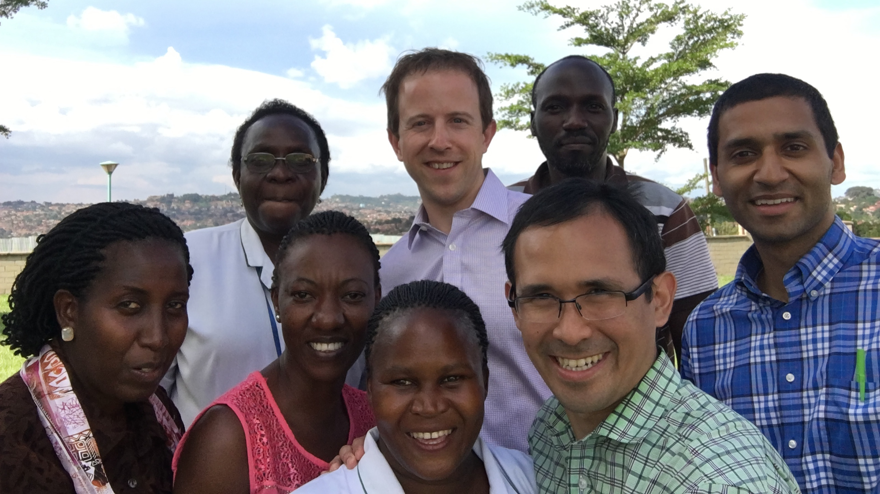
Thank you
Case Western/UH:
Grace McComsey
Brian Hoit
Dan Simon
Mark Schluchter
Ben Alencherry
Robert Gilkeson
Cleveland Clinic
Wilson Tang
University of Edinburgh:
Anoop Shah
University of Cincinnati:
Moises Huaman
Carl Fichtenbaum
Makay Memorial Hospital (Taiwan):
Chun-Ho Yun
Chung-Lieh Hung
Massachusetts General Hospital
Mark Siedner
Joint Clinical Research Centre:
Cissy Kityo
Grace Mirembe
Joselyne Nansimbe
Rashida Nazzinda
Nsambya St. Francis Hospital:
Geoffrey Erem
Andrew Ocheng
Uganda Heart Institute:
Emmy Okello
Isaac Ssinabulya
Makerere School of Medicine:
Moses Kamya
Funding:
NIH
K23 HL123341
Medtronic Philanthropy
Wolf Family Foundation
U of Cincinnati Dept of Medicine
Study nurses and participants in Cleveland and Uganda
Notes:
Thank you to all our collaborators, funders, and especially the study nurses and participants in Cleveland and Uganda. Thanks!

